Slide 1
LEIBNITZ THEOREM
Nazmul Kader Chowdhury

Slide 2
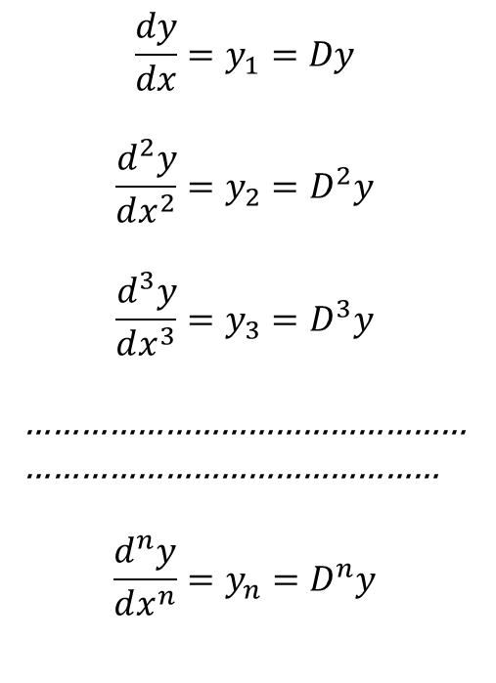
$$\frac{dy}{dx}=y_{1}=Dy$$
$$\frac{d^{2}y}{dx^{2}}=y_{2}=D^{2}y$$
$$\frac{d^{3}y}{dx^{3}}=y_{3}=D^{3}y$$
…………………………………………
………………………………………
$$\frac{d^{n}y}{dx^{n}}={y_{n}=D}^{n}y$$

Slide 3

LEIBNITZ THEOREM

Slide 4
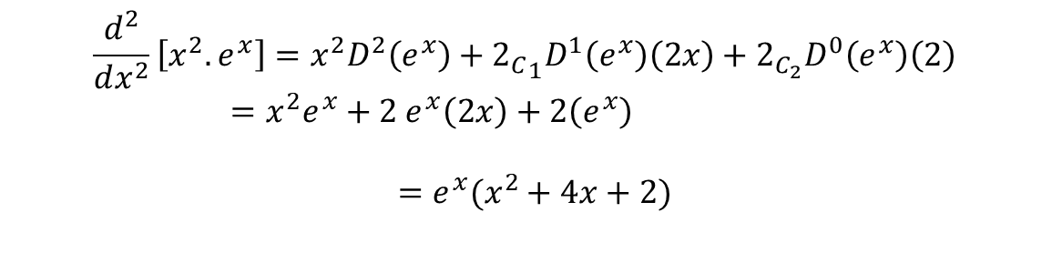
Example
$$\frac{d^{2}}{dx^{2}}\left[x^{2}.e^{x}\right]=x^{2}D^{2}\left(e^{x}\right)+{2_{C}}_{1}D^{1}\left(e^{x}\right)\left(2x\right)+2_{C_{2}}D^{0}\left(e^{x}\right)\left(2\right) =x^{2}e^{x}+2 e^{x}\left(2x\right)+2\left(e^{x}\right)$$
$$=e^{x}(x^{2}+4x+2)$$

Slide 5
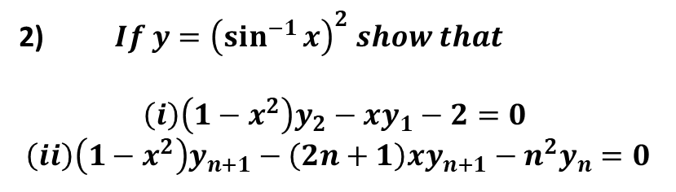
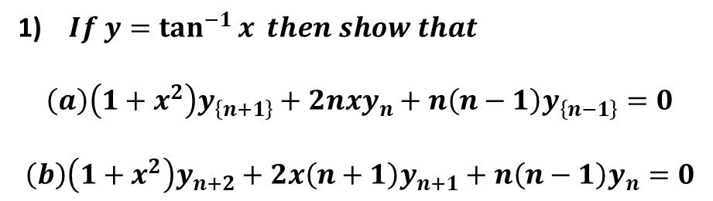
Problems
1) $If y=\tan^{−1}{x} then show that$
$$\left(a\right)\left(1+x^{2}\right)y_{\left\{n+1\right\}}+2nxy_{n}+n\left(n−1\right)y_{\left\{n−1\right\}}=0$$
$$\left(b\right)\left(1+x^{2}\right)y_{n+2}+2x\left(n+1\right)y_{n+1}+n\left(n−1\right)y_{n}=0$$
2) $If y={\left(\sin^{−1}{x}\right)}^{2} show that$
$$\left(i\right)\left(1−x^{2}\right)y_{2}−xy_{1}−2=0$$
$$\left(ii\right)\left(1−x^{2}\right)y_{n+1}−\left(2n+1\right)xy_{n+1}−n^{2}y_{n}=0$$

Slide 6
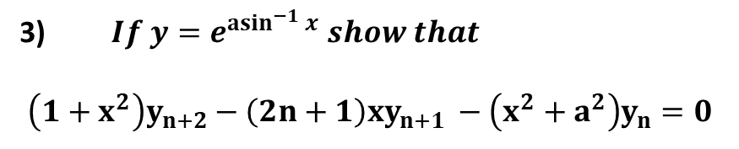
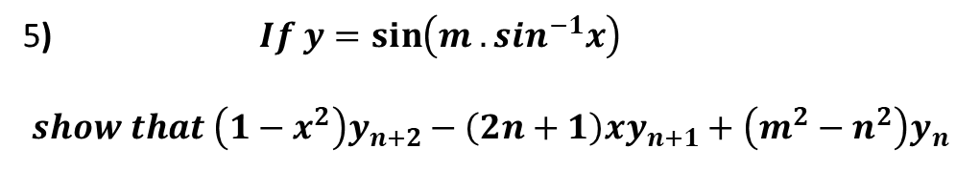
3) $If y=e^{{asin}^{−1}{x}} show that$
$$\left(1+x^{2}\right)y_{n+2}−\left(2n+1\right){xy}_{n+1 }−\left(x^{2}+a^{2}\right)y_{n}=0$$
$$4) If\log{y=\tan^{−1}{x}then show that \left(1+x^{2}\right)y_{n+2}+\left(2nx+2x−1\right)y_{n+1}+n\left(n+1\right)y_{n}}$$
5) $If y=\sin\left(m .sin^{−1}x\right)$
$$show that \left(1−x^{2}\right)y_{n+2}−\left(2n+1\right)xy_{n+1}+\left(m^{2}−n^{2}\right)y_{n}$$

